Slide 1
POST-ELECTION ANALYSIS
DR JOHN OSTROWICK

Slide 2
CONTENTS
Statistics
2021 Prediction came true
Results
Turnout
Demographics
Results: Demographics
Results: KZN
Response: "The Markets"
Analysis
Questions
Answers
Recommendations

Slide 3
STATISTICS

Slide 4
2021 Prediction came true
Source: Own graph

Slide 5
Results
Source: IEC

Slide 6
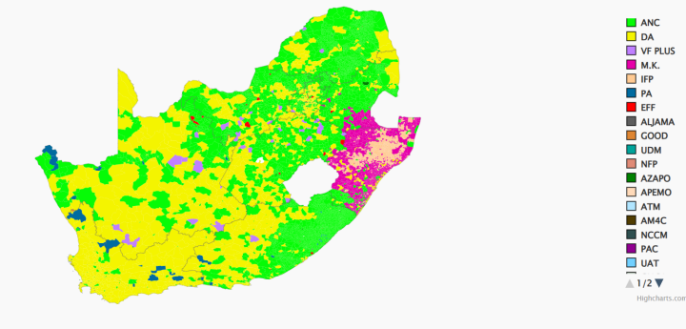
Results
Source: IEC

Slide 7
Turnout
Source: IEC

Slide 8
Let's overlay those two
Source: IEC data

Slide 9
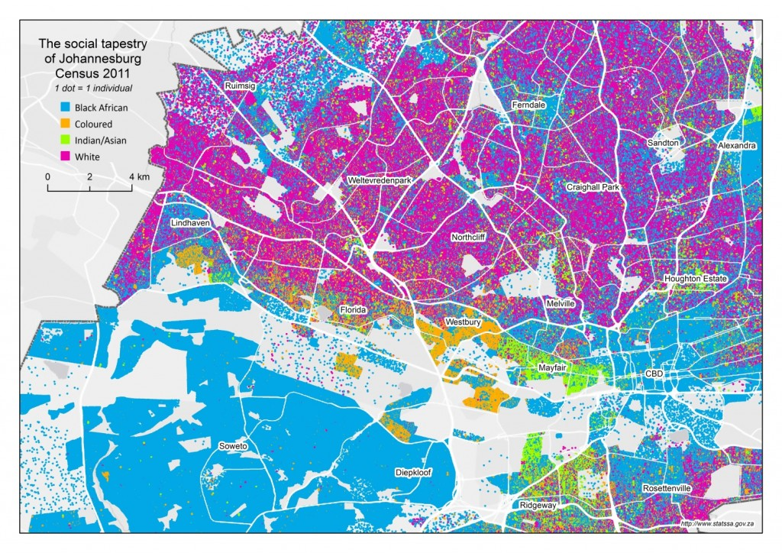
Demographics
Suburbs
CBD
SOW
Source: StatsSA 2011 https://www.statssa.gov.za/?p=7678

Slide 10
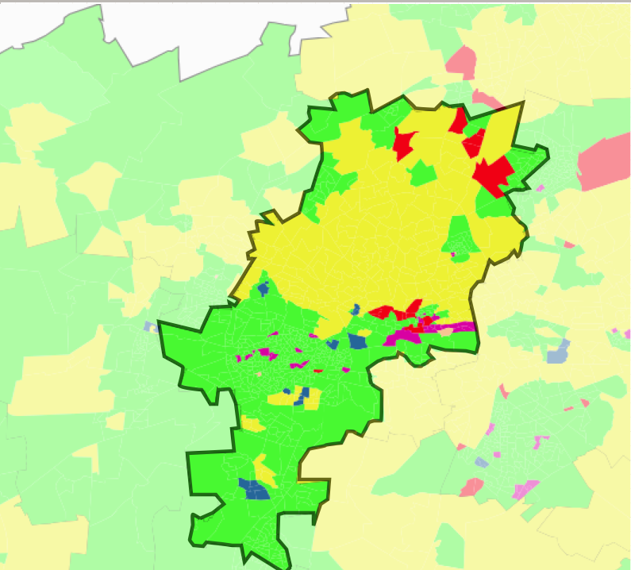
Results: Demographics
JHB
SOW
Source: StatsSA 2011 https://www.statssa.gov.za/?p=7678

Slide 11
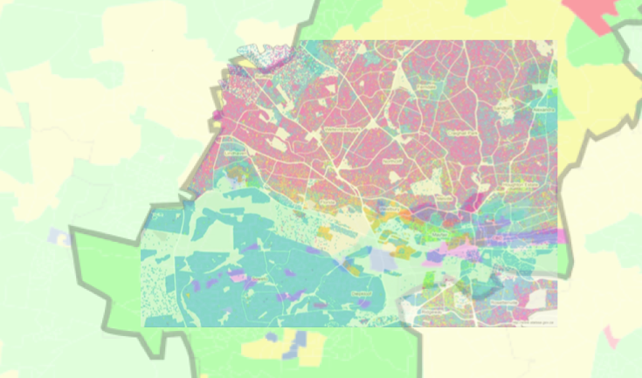
Let's overlay those two.
Source: StatsSA 2011 https://www.statssa.gov.za/?p=7678

Slide 12
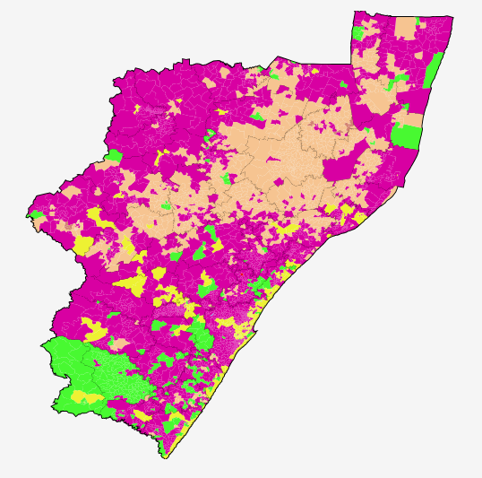
Results: KZN
Source: IEC

Slide 13
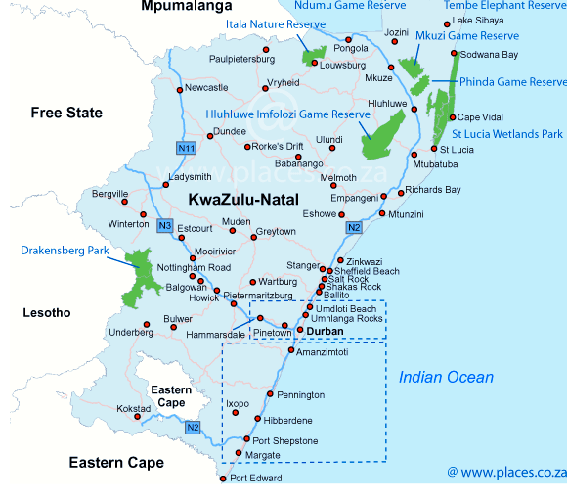
KZN cities
Source: places.co.za

Slide 14
Let's overlay those two.
Source: IEC and places.co.za

Slide 15
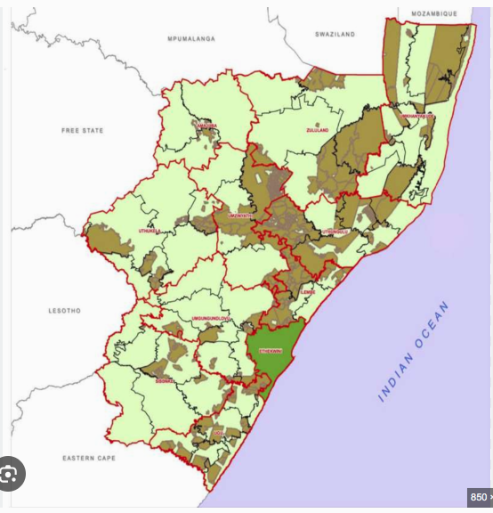
Is it "traditionalism"?
Source: Ingonyama Trust

Slide 16
Let's overlay those two.
Source: IEC and Ingonyama Trust

Slide 17
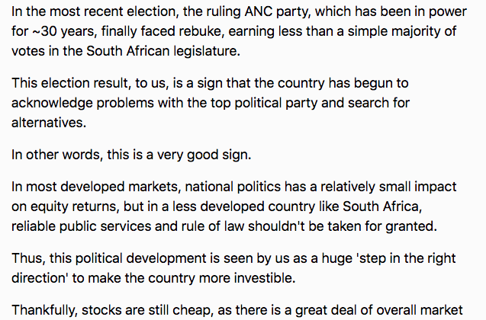
Response: "The Markets"
https://seekingalpha.com/article/4703854-the-investment-case-for-south-africa-eza-is-the-ultimate-buy-low-opportunity

Slide 18
ANALYSIS

Slide 19
Analysis
Turnout in part caused the decline plus...
People vote by race, plus we see correlation with traditional/rural areas and both MK/IFP, vs ANC/DA for towns
MK was a vote for FP Cde JZ.
People didn't really change their vote from ANC to anything else except MK.
Total ANC 2019: 57%. MK 2024 + ANC 2024 = 55.
We only lost 2% plus the JZ faction.

Slide 20
Questions
Why the lowest turnout?
Why do people still vote by race/area in 2024?
Why did people vote for JZ, especially in KZN?
Why are "the Markets" rejoicing?

Slide 21
Answers
The triple challenges prevent people from seeing meaningful change in their lives.
They vote ANC out of habit, but, can't justify cost of travel/time to a voting station.
The oldest person who remembers apartheid is now about 23 years old. But 45.5% of those youths are unemployed. So why should they care when (a) they never knew how bad apartheid was and (b) they're unemployed? https://www.statssa.gov.za/?p=17266

Slide 22
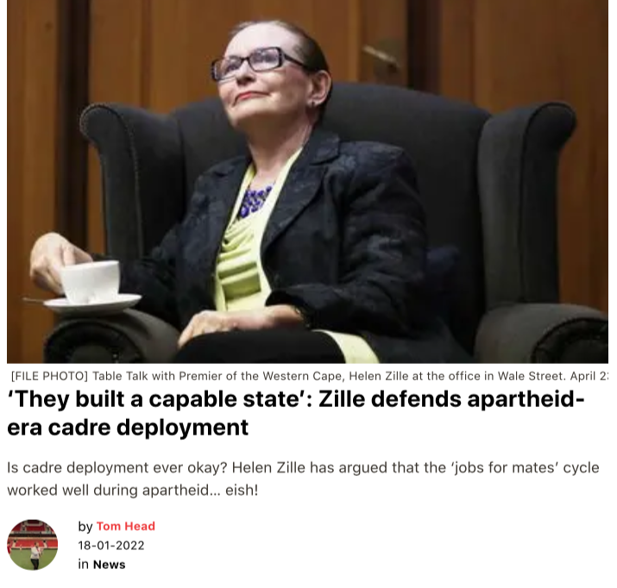
Answers
Because many people are still racist.
https://www.thesouthafrican.com/news/breaking-helen-zille-twitter-posts-cadre-deployment-apartheid/
By Tom Head in The South African, 18-01-2022

Slide 23
Answers
Support for JZ remains poorly understood.
We see that rural/Ingonyama Trust lands correlate with MK and IFP respectively, but only loosely
We see that towns in KZN are either DA or ANC depending on demographics
Apparently Zondo did not tarnish FP Cde JZ's image in KZN. We saw the riots July 9, 2021 which were a response to, or triggered by, his imprisonment — and did not take that as an electoral warning.

Slide 24
RECOMMENDATIONS

Slide 25
Recommendations
Create jobs (discussion to follow). That missing 40% of voters would push us to close to 80%
Engage white community constructively rather than adversarially, re the DA — eg why do they still vote for a manifestly racially biased party? — If they could be persuaded, we would have at least 50% even 60%

Slide 26
Recommendations
Support for JZ needs to be understood in non-bigoted manner, e.g. what the voters see in him, e.g. Is it his leadership style, personality, etc. What is the JZ faction really about? How is factionalism destroying us? Is there a way to engage with JZ? If we could succeed in getting these voters back, we'd have 55% of the vote.
If we look at the above recommendations coldly, the most powerful route with the biggest gains is job creation (1), but the easiest is trying to engage JZ (3).

Slide 27
Recommendations
The Markets. Clearly "the Markets" response is a reflection of the hope that more DA presence in government means more "investor-friendly" policies. As we are short of job creation opportunities, we should take this positive attitude as an opportunity to encourage local investment by FDI as long as it is about creating local jobs and not exporting capital via say the mortgage/bond market.

Slide 28
Thank You!

